Slide 1
Final project
Cryptography

Slide 2

Team
Abdulrhman Amr
Amr Khaled
Momen Ameer
Abdulrhman Khaled
Ahmed Ismael
Badr Elwgod

Slide 3

Agenda
01
02
03
05
Groupe
Mono-Alpha
Vigenère
And The new Algorithm
Algo Brief
Algo Brief
04
Base64
Tkinter
Encruption Brief
Python GUI

Slide 4
01
Groupe 3
Mono-Alpha, Vigenère, and Base64

Slide 5
02
Mono-Alpha
Learn more about it

Slide 6
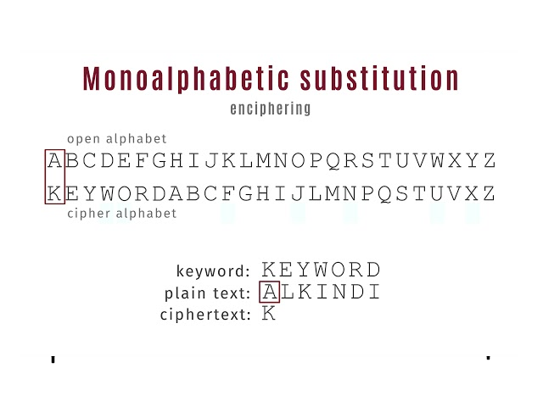
Mono-Alpha

Slide 7
Mono-Alpha
Mono-alpha has list of all characters then:-
Make a random arrangement of the characters
Shift the true characters index with new string
Formula (plaintext_index + cipher_index % 26)
Repeat for each character until the end of the string

Slide 8
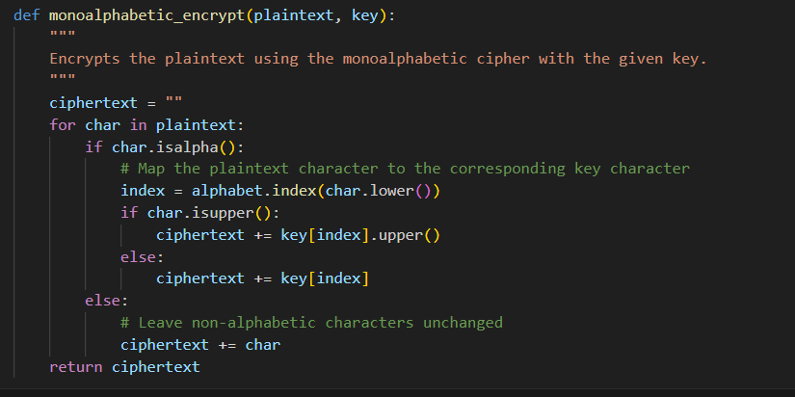
Mono-Alpha

Slide 9
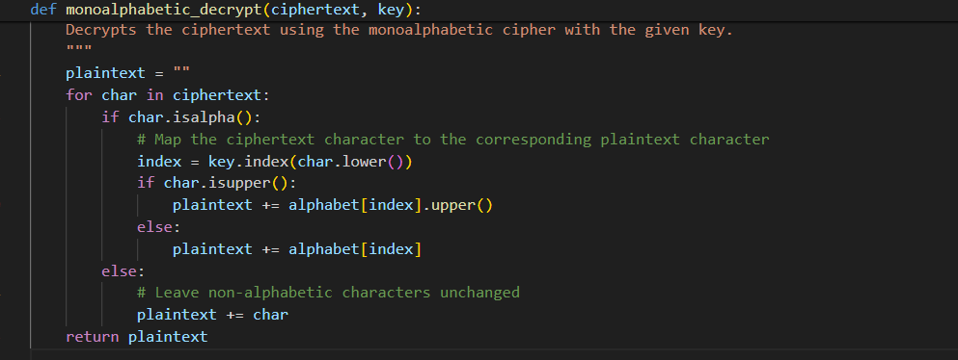
Mono-Alpha

Slide 10
03
Vigenère
Learn more about it

Slide 11
Vigenère
Vigenère cipher looks like Caesar cipher key is a word (e.g. root )
The key is a word that the plaintext is shifted by it.
Shift first litter of plain with the first in the key
Formula (plaintext_index + cipher_index % 26)
If the plaintext is longer than the key it repeats the litters until fits it
If smaller split the key to match the size of the plaintext

Slide 12
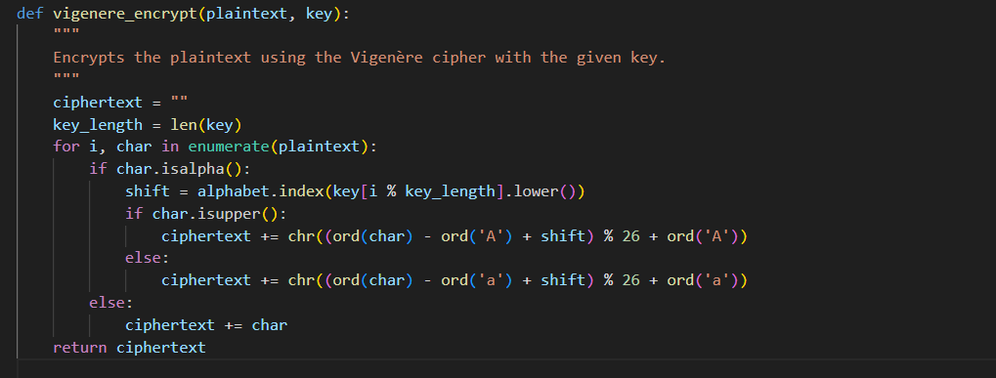
Vigenère

Slide 13

Vigenère

Slide 14
04
Base64
What is it and how to use

Slide 15
Base64
Base64 is an encryption method that:-
Uses a set of symbols and letters to represent the output
The term 64 means it has 64 symbols to represent
Needs first to convert input to the binary form so the ASCII is required
Takes each 3 character and produce 4 character output

Slide 16
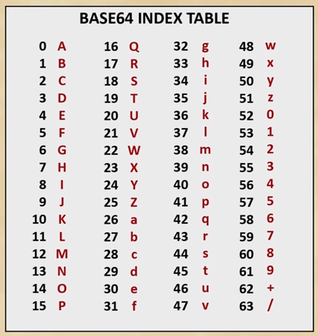
Base64

Slide 17
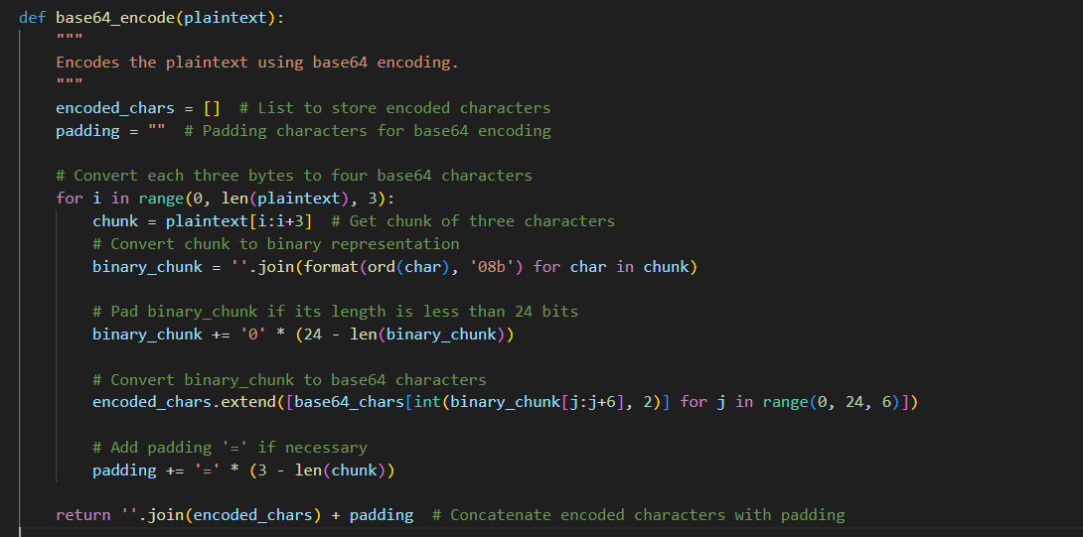
Base64

Slide 18
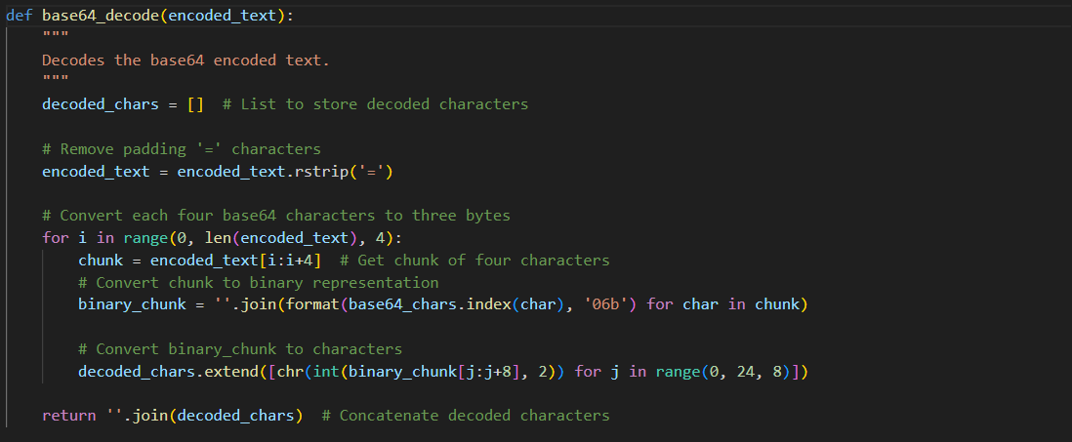
Base64

Slide 19
04
Tkinter
GUI used

Slide 20
Tkinter
A python built in library for GUI, I used:-
Window Title
Radio Buttons
Input Text Area
Key entry: used field labeled ‘Key’
Encryption Decryption Buttons
Output Text Area

Slide 21
Thank you💖

